Slide 1
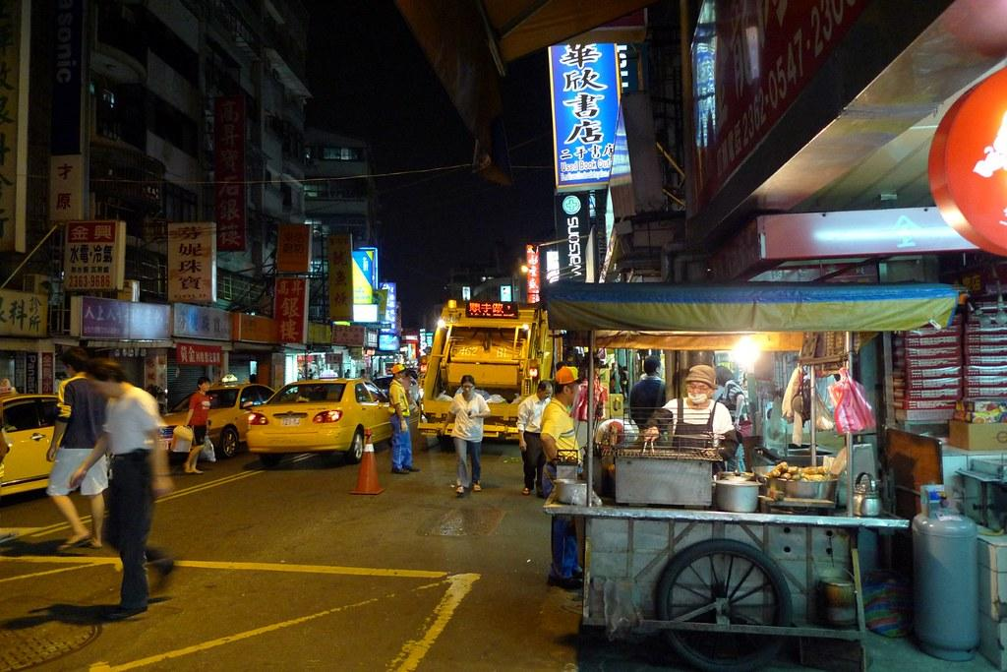
Garbage Time!
by Matthew Holland
MGT 8823

Slide 2
Define: Business Case
Taiwan has a surprisingly interesting history regarding sanitation. For many years, large trash bins, commonly called Dumpsters, were spread throughout the cities.
However, due to the tropical climate, many critters took over these areas and made for quite an unpleasant scene. In response to this, the Taiwanese government took the drastic measure of charging the population with taking care of their own sanitation. At different intervals throughout the day, people need to wait for the garbage truck, compost truck, and recycling truck to dispose of their trash. This process helps people to be more aware of the waste that they produce. This process has been successful, but is it running as smoothly as it possibly can?

Slide 3
Define: Problem
Goal
The garbage collection service near my home is spending too much time collecting trash. On average, they spend 5 minutes and 57 seconds collecting trash during each session.
The garbage collection service will shave 10 percent off of the time that they currently spend collecting trash. In other words, the time will reduce to 5 minutes and 27 seconds of trash collection time per session.

Slide 4
Define: Operational Definition
Y Variable:
Garbage Collection Time (Continuous): This is measured in seconds. The data was collected manually with a stopwatch app on a mobile phone.

Slide 5
Define: Operational Definition
X variables:
Day of the Week (Categorical)
Type of Recycling (Categorical)
Truck Arrival Order (Categorical)
Garbage Truck Time (Continuous)
Recycling Truck Time (Continuous)
Food Waste Truck Time (Continuous)

Slide 6
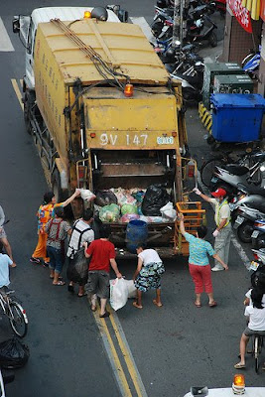
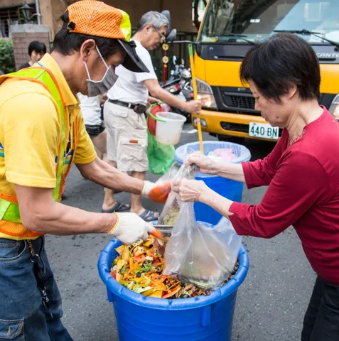
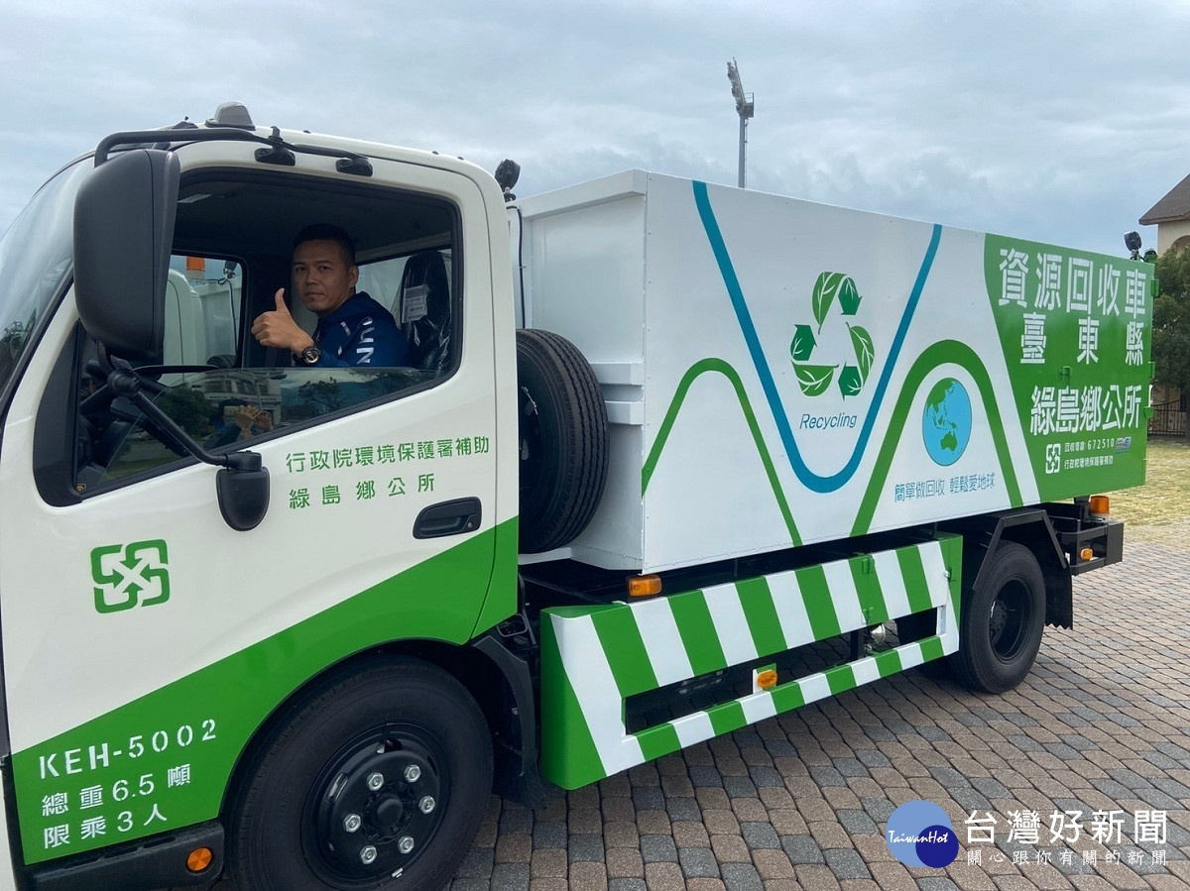
Define: Operational Definition
These are the three types of sanitation trucks in Taiwan. On the left is the garbage truck. In the middle is the food waste/compost truck. On the right is a recycling truck.

Slide 7
Measure: Data Collection Plan
Project: Measure Garbage Collection Times in Taipei City
What questions do you want to answer? Are the garbage trucks in my neighborhood spending the appropriate amount of time at my stop? Could the labor force be reduced or put to work more efficiently?
How was the data recorded? The times for each page reading were recorded in Microsoft Excel. Subsequently, the data was transferred to the Microsoft Excel sheet provided by the instructor.
How did you ensure consistency and stability? The sanitation trucks stop at my house twice a day, but I only kept data for the evening garbage collection. I kept track of the time for the stop on five days of the week, Mondays, Tuesdays, Thursdays, Fridays, and Saturdays. There is no garbage collection on Wednesdays or Sundays. I started the timer when the first truck arrived, and I ended the timer when the last truck left.

Slide 8
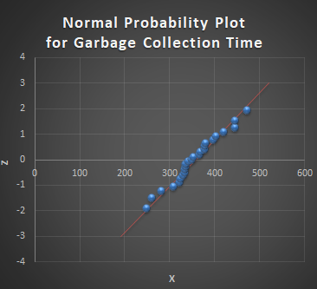
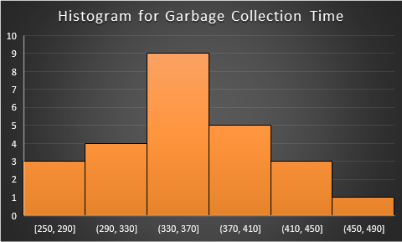
Measure: What are we working with?
Average | 356.72
St Dev | 54.97
n | 25
Median | 349
S | -623.52
AD | 0.301
AD* | 0.311
p Value | 0.554
Min | 250
Max | 472
With a p-value greater than 0.05, we fail to reject the null hypothesis of normality. The normal probability plot and histogram show the shape of a normal distribution. The histogram shows low variance since many points lie in the bin near the center. However, the histogram is skewed slightly left. There are no outliers. Therefore, we will use the average (mean) to center our data. The data was collected successfully.

Slide 9
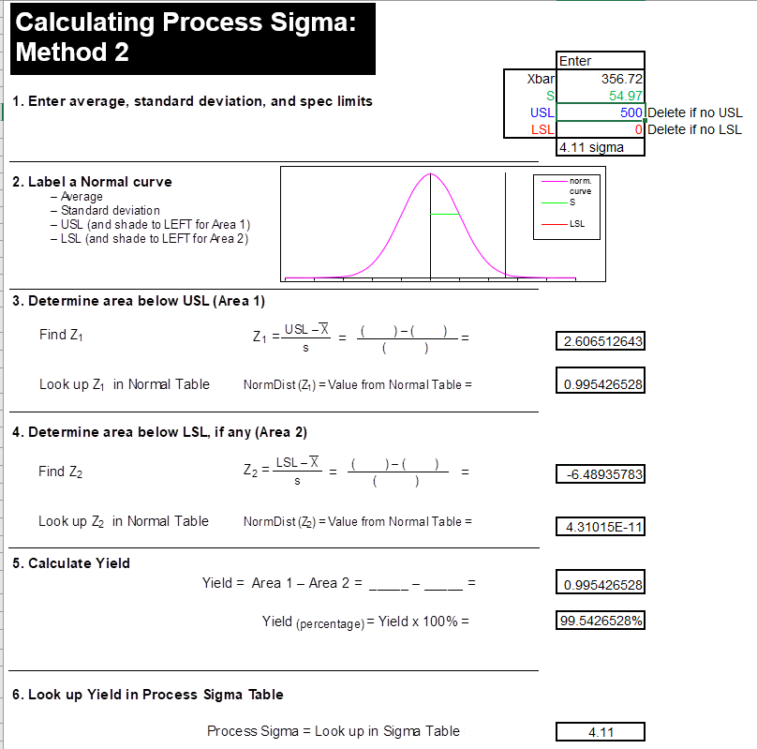
Measure: How well are we doing?
With an upper spec limit of 500 seconds, the process has a 99.54% chance of being completed on time. A score of 4.11 sigma is quite good, but could be improved.

Slide 10
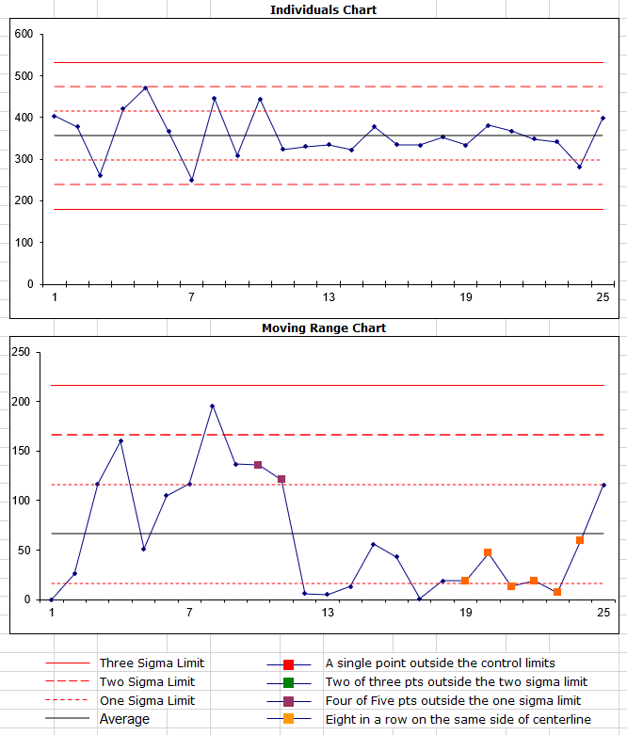
Measure: Are we consistent?
An analysis of the control chart for the garbage collection times shows a fairly stable process as all points fall within 2 standard deviations of the mean. The process was much more stable over the second half of data collection with a slight uptick in the last data point collected. This process does not appear to have assignable-cause variation.

Slide 11
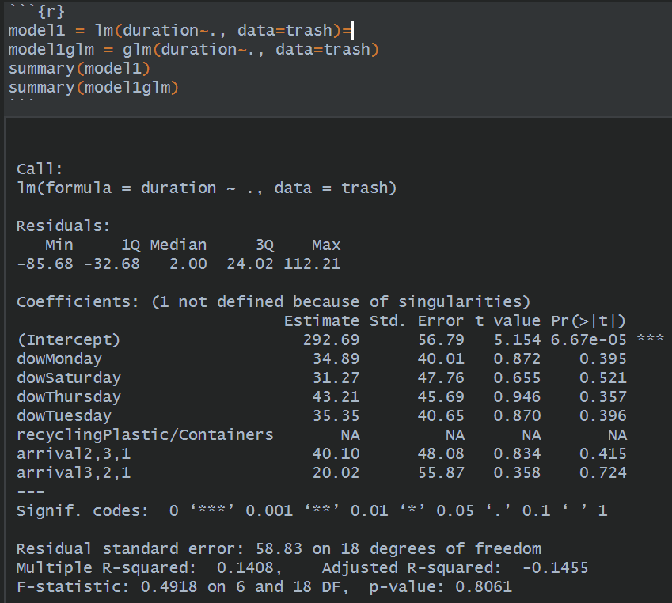
Analyze: Linear Regression
A linear regression model, calculated in R, with average collection time (time from when the first truck arrived to when the third truck left) as the y-variable and the three x-variables (day of the week, type of recycling, arrival order) contains high p-values, indicating that they may not be statistically significant. In addition, the R-squared values are quite low. This is further evidence that there is not assignable-cause variation in this process. I would not feel comfortable using this model to make predictions. The x-variables might possibly grow to be more significant with a larger dataset.

Slide 12
Analyze: Regression RElated Stats
 | Average Collection Time (in seconds)
Truck #1 (Garbage) | 172
Truck #2 (Food Waste & Compost) | 317
Truck #3 (Recycling) | 315
Monday | 364
Tuesday | 363
Thursday | 376
Friday | 323
Saturday | 344
Paper Recycling | 348
Plastic/Containers Recycling | 363
2,3,1 Arrival Order | 366
3,2,1 Arrival Order | 329
1,2,3 Arrival Order | 326
Truck #1 spends the least amount of time at my stop while truck #2 and truck #3 spend a much longer time there. When the day of the week is analyzed, we can see that Friday is the day with the shortest collection time, while Thursday is the longest. However, the difference is not large enough to show causation with such a small sample size. The type of recycling and arrival order also do not show major differences.

Slide 13
Analyze: Fishbone Diagram
Worker Distribution
There are two workers in truck #1, yet its process takes the least amount of time.
There is one worker in truck #2, yet its process takes the longest amount of time.
There are three workers in truck #3, yet its process takes almost as long as the process in truck #2.
Inefficient Collection
Truck #2 (Compost) does not have sufficient space for people to line up, causing unnecessary waiting.
Problem: The garbage collection time is too long.
Waiting Time
Workers often sit idle while they are waiting for other trucks to finish their process.
Worker Inactivity
One of the workers in truck #1 does not help with the collection process, he only drives the truck.
Notes:
© Copyright PresentationGO.com – The free PowerPoint and Google Slides template library

Slide 14
Analyze: Value Stream Map
I take my plastic bag with food waste, plastic bag with compost, plastic bag with recycling, and plastic bag with garbage outside to the garbage truck. | I throw away my empty plastic bag in the center garbage can. | I place my plastic bags into the big plastic bag held by recycling truck worker #1. | I wait for the garbage truck to stop.
 | I throw the compost into the compost container on the compost truck. | I wait in line to throw my recycling into the recycling truck. | I throw my garbage bag directly into the garbage truck.
I wait for the garbage truck, compost truck, and recycling truck to arrive. | I throw away my empty plastic bag in the center garbage can. | I hand my plastic bag containing paper recycling to recycling truck worker #2 (Monday, Friday) | I hand batteries to garbage truck worker #1 for recycling.
I wait for the compost truck to stop. | I walk over to the recycling truck. | I hand my plastic bag containing plastic/containers recycling to recycling truck worker #2 (Tuesday, Thursday, Saturday) | I take my plastic bag for recycling back home.
I wait in line to throw food waste (later fed to pigs) and compost into the compost truck. | I wait for the recycling truck to stop. | I take my plastic bag back from recycling truck worker #2.
I throw the food waste into the food waste container on the compost truck. | I wait in line to recycle my plastic bags in the big plastic bag held by recycling truck worker #1. | I walk over to the garbage truck. | Text in green is value-added. Text in red is Non-value added.

Slide 15
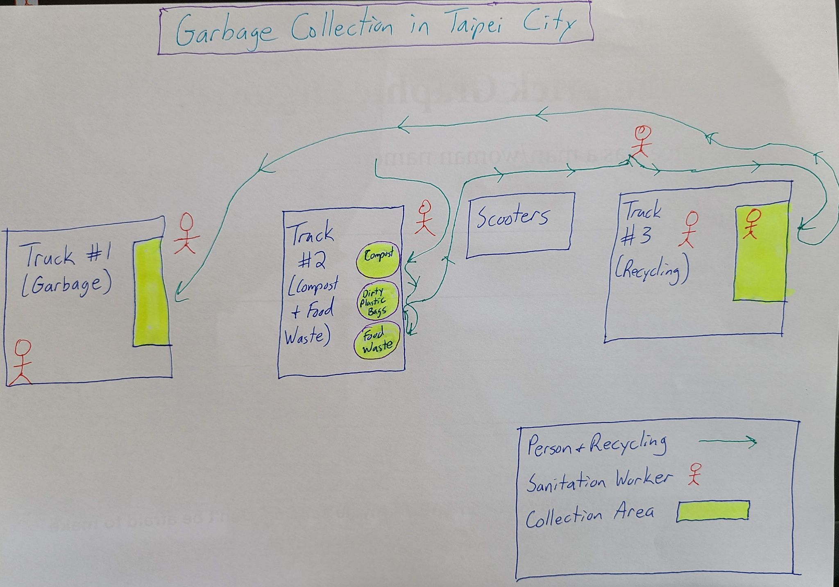
Analyze: Spaghetti Diagram
On the spaghetti diagram, we can see that truck 1 is efficient, as people just throw the trash directly into the truck. Truck 2 is a bit inefficient as there is little space to dispose of garbage. In addition, it can take time throw compost, plastic bags, and food waste into the different receptacles. Truck 3 is quite efficient. First plastic bags are given to the first worker, and then the recycling is given to the two workers who help the citizens to place the recycling into larger bags.

Slide 16
Improve: PICK Analysis
Possible | Implement
Kill | Challenge
Have sanitation workers work seven days a week instead of five.
Have the second worker from the garbage truck help the workers in trucks 2 and 3.
Move the food waste truck to a location where there is more space for people to line up.
Hard Difficulty Easy
Combine all garbage, food waste, and recycling onto only one truck to streamline the process.
Have nine workers working on the sanitation crew instead of six.
Low Payoff High

Slide 17
Improve: Action Plan
The x-variables that I chose did not inform a specific plan. Therefore, my plan is to shave ten percent off of the collection time by implementing the following changes.
Take a worker from the garbage truck, and have him help with the food waste truck or the recycling truck.
Expand the area where people dispose of food to make the foot traffic movement more efficient.
Ensure that the trucks do not necessarily need to arrive and depart at the same time. This will allow some trucks to get a head starts on other ones.

Slide 18
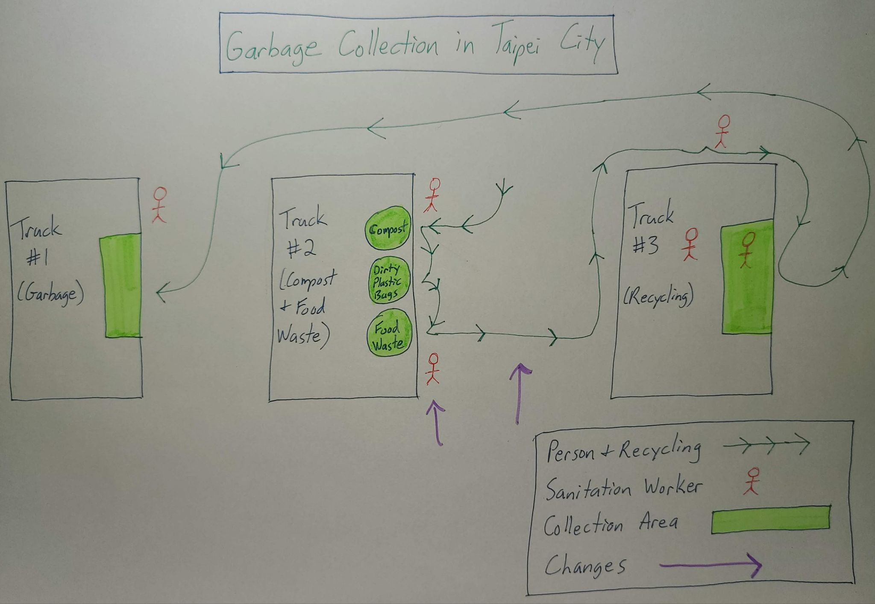
Improve: Spaghetti Diagram
The process has been improved by moving a sanitation worker to truck #2 and by increasing the space for people to line up at truck #2. The worker from truck #1 also has the option of helping truck #3 if they need help to speed up their process.

Slide 19
Conclusion
Taipei has successfully implemented a creative process to efficiently dispose of waste in the city.
This system is a stable process at the moment, but there are always ways to improve upon a stable process. Decreasing the time spent at each stop could save millions of dollars for the government in labor costs. In addition, finding better places to line up in front of the trucks would make things more convenient for both citizens and workers.
These are just a couple of ideas for improving upon an already thriving process. I am excited to see an even more stable process for keeping Taipei clean.

